Slide 1
How To Train Your Deep Multi Object Tracking
Pallavi Pamulapati 2020101095
Aishwaryabharathi 2020102060
Shriya Dullur 2020102006
Keerthi Pothalaraju 2020102010

Slide 2
Motivation
Deep learning can be used to train the multi- object tracking. Existing methods train only certain sub-modules using loss functions. Which do not often correlate with the evaluation metrics – MOTA and MOTP
As these measures are non-differentiable, we cannot directly use them to optimize the loss functions. Hence, this paper proposes DeepMOT.
DeepMOT is a framework to train multi-object trackers including the DeepMOT Loss that directly co-relates with the established tracking evaluation metrics.
A differential framework of Deep Hungarian Network is introduced which provides the approximation of the Standard Hungarian Algorithm used for getting the optimal predicted-to-Ground truth assignment.

Slide 3
CLEARMOT
The MOT’s main task is to accurately estimate the bounding boxes for all the identities(objects) through time. It’s objective is to predict tracks in a video sequence.
At a frame t, the predicted bounded boxes(N_{t}) are compared with the ground-truth objects(M_{t})
Intersection over-Union(IoU) metric is used to obtain distance matrix(D_{NxM})
Optimal Prediction-To-Ground truth assignment binary matrix is obtained by using Hungarian Algorithm.

Slide 4
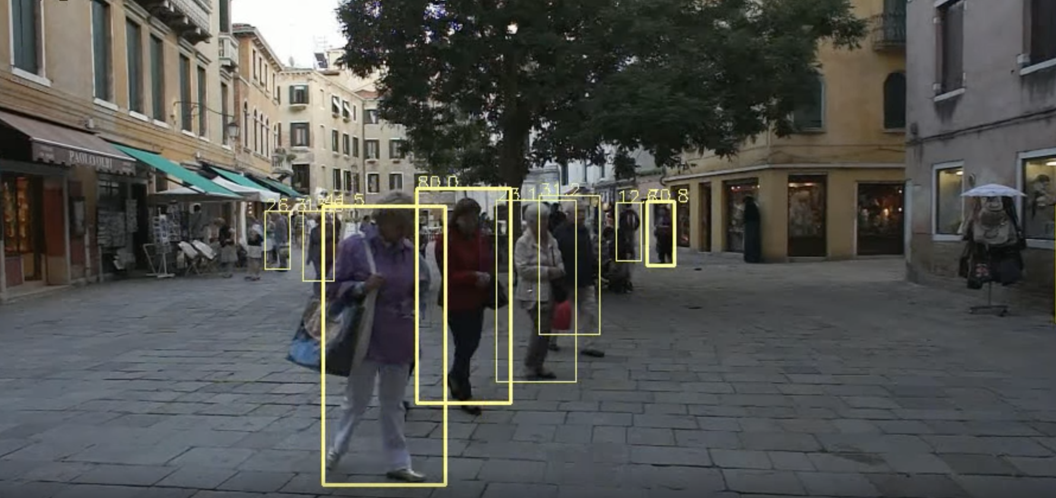
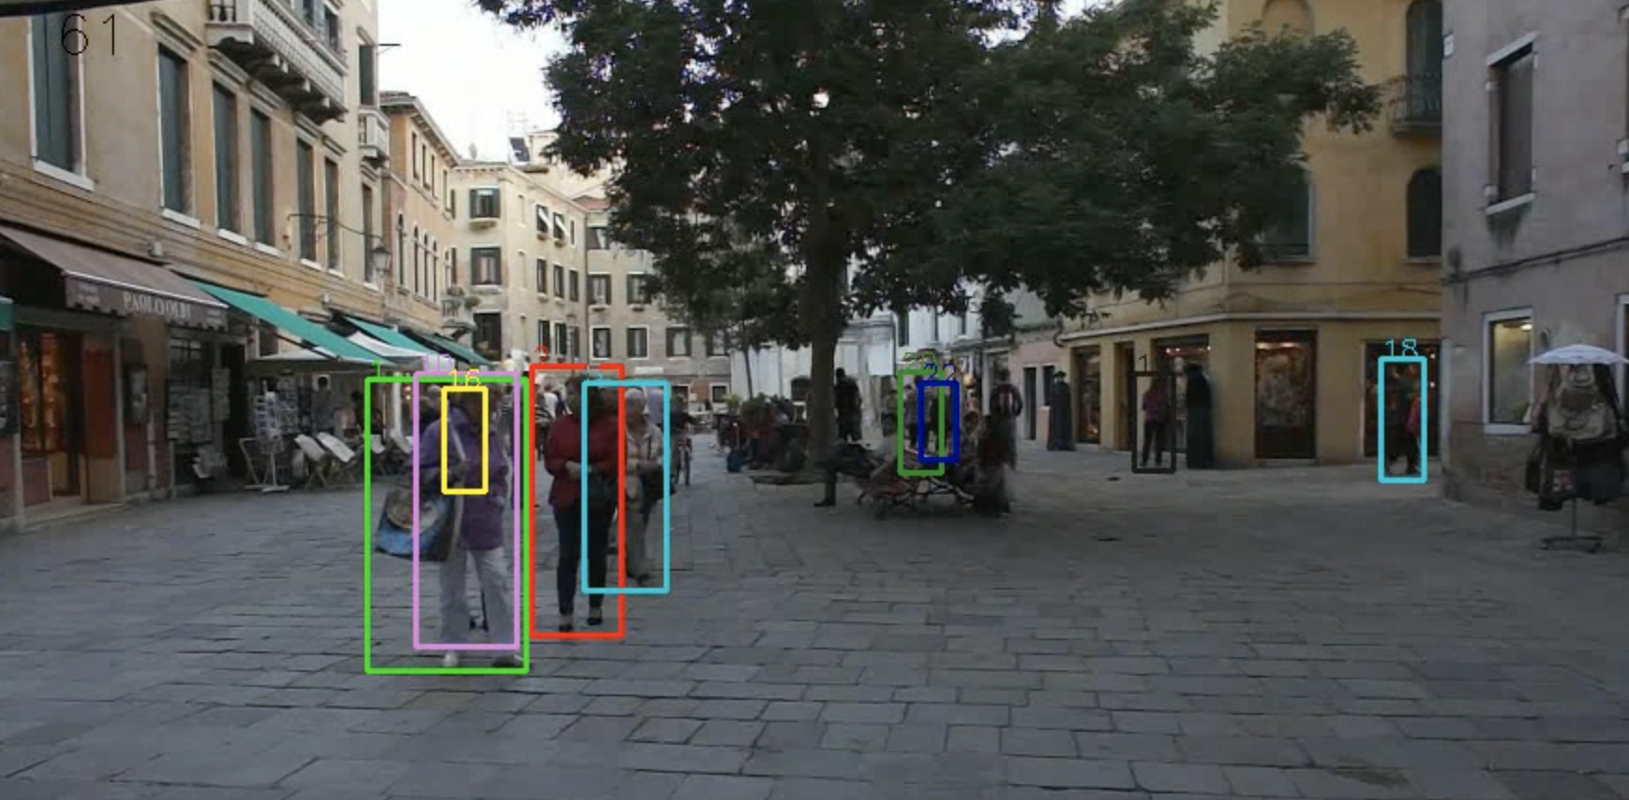
Public Detections / Tracks
Ground Truths

Slide 5
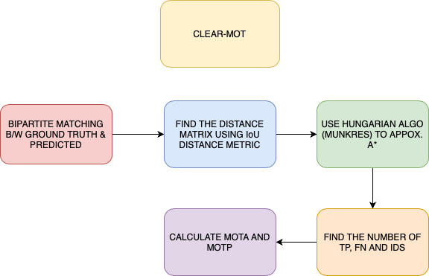

Slide 6
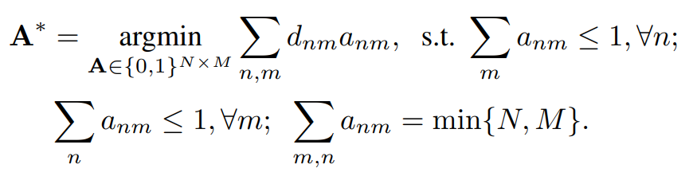
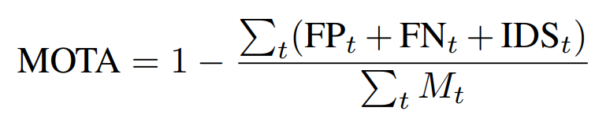
Hungarian Algorithm
Where, A* is the optimal association between ground-truth objects and track predictions
After getting A*, following evaluation measures are computed
Multi-Object Tracking Accuracy(MOTA)

Slide 7
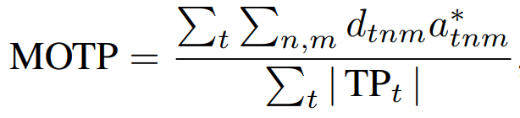
Multi-Object Tracking Precision
The above evaluation metrics are only useful for optimization of tracker’s hyperparameters and are non- differentiable.
This paper derives a Loss function using evaluation metrics like MOTA and MOTP, such that they can be directly used for tracker optimization with gradient descent techniques.

Slide 8
Idea Proposed
Loss function that is directly inspired by the standard MOT evaluation measures for end-to-end training of the multi object trackers.
Deep Hungarian Net is proposed to match the predicted tracks to the ground truth objects in a differentiable manner by back propagating losses.
The approximation is based on Bi-Recurrent Neural Network that computes the soft assignment matrix based on prediction-to-ground-truth distance matrix.

Slide 9
Deep Hungarian Net : DHN
We formalize DHN with a non-linear mapping that inputs D and outputs the proxy soft assignment matrix A' .
DHN is modeled by a neural network A' = g(D, ω) with parameters ω_{d}.
DHN produces a proxy A' that is differentiable with respect to D.
Importantly, the DHN mapping must satisfy several properties:
(i) the output A' must be a good approximation to the optimal assignment matrix A*
(ii) this approximation must be differentiable w.r.t. D
(iii) both input and output matrix are of equal, but varying size
(iv) g must take global decisions as the HA does.

Slide 10
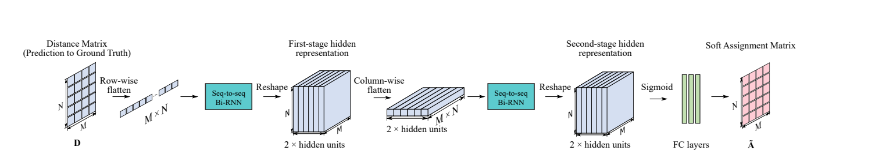
The proposed approximation is based on a bidirectional recurrent neural network (Bi-RNN) that computes the (soft) assignment matrix based on the prediction to-ground-truth distance matrix.
The row-wise flattened D is input to a first Bi-RNN that outputs the first-stage hidden representation of size N × M × 2h, where h is the size of the Bi-RNN hidden layers.
The first-stage hidden representation are flattened column-wise, to input to a second Bi-RNN that produces the second-stage hidden representation of size N × M × 2h.
we feed the second-stage hidden representation through three fully-connected layers. Finally, a sigmoid activation produces the optimal N × M soft assignment matrix A' .
Through DHN, the gradients from the approximated tracking performance measures are back-propagated to update the tracker weights.

Slide 11
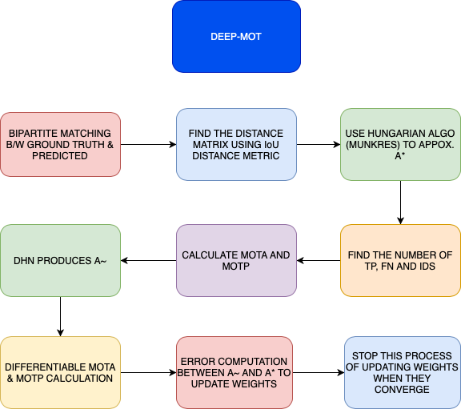

Slide 12
Differentiable MOTA And MOTP
To make MOTA and MOTP differentiable (I.e. dMOTA and dMOTP) we express FN, FP, IDS as functions of D and Ã.
To find soft approximations of FP and FN, we construct matrices C^{r} and C^{c} by appending a column and row to Ã respectively, filled with threshold value.
Next, we perform row-wise SoftMax and column-wise SoftMax. The resulting sum of elements in C^{r}_{n,M+1} and C^{c}_{N+1,m} gives us the soft approximations of FP and FN respectively.
To compute soft approximations of IDS and MOTP, we construct two additional binary matrices B^{TP} and B₋₁^{TP}, whose non-zero entries represent true positives in the time frames t-1 and t respectively.
To get the number of ID switches we take a l1 norm of the matrix obtained by dot product of B^{TP} and binary complement of B₋₁^{TP} .

Slide 13
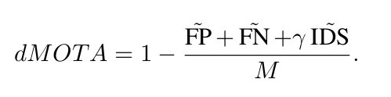
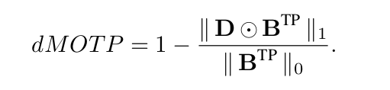
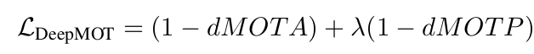
DIFFERENTIABLE LOSS FUNCTION
From the above calculations we get dMOTA and dMOTP as:
As we train our tracker to maximize MOTA and MOTP, the loss function can be
Where λ is the loss balancing factor

Slide 14
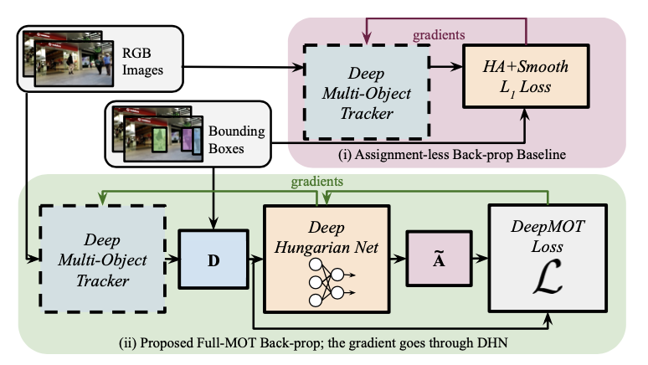
HOW TO TRAIN YOUR DEEP MULTI-OBJECT TRACKER
We can observe the overall tracker procedure in this diagram:
Given a video sequence, a pair of consecutive frames will be taken. Initialize the tracks with the ground truth boxes in time frame t and run the forward pass to obtain predicted bounding boxes.

Slide 15
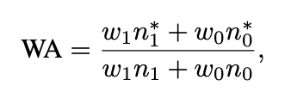
DHN TRAINING:
We then compute the distance matrix D and use our proposed DHN to compute A~
We compute loss based on D and A~
This provides us the gradient that accounts for the assignment, and that is used to update the weights of the tracker.
A dataset is created with matrices D and A* seperated into training and test sets. The matrix D is the distance matrix which is found by comparing the ground-truth and predicted bounding boxes.
We can evaluate the performance of DHN by computing weighted accuracy (WA):

Slide 16
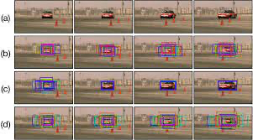
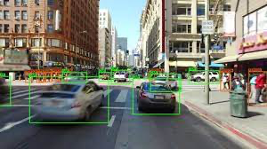
EXPERIMENTAL SETTINGS:
For our experimentation, we will be using pedestrian video sequences captured in the real world scenarios, so we will be using datasets like MOT15 or MOT16.Then, we divide the dataset into training and validation.
We calculate entities like MOTA and MOTP, along with that we can also observe the performance using IDF1
From this, we can report the mostly tracked and mostly lost targets.
We can evaluate the performance of DHN by computing weighted accuracy (WA):

Slide 17
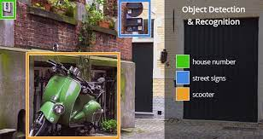
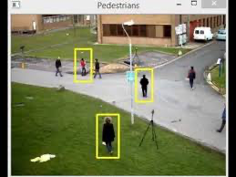
TRACKTOR+ReID:
Tracktor is an adaption of Faster RCNN, it is used for detecting objects and following the detected targets in consecutive frames. It was originally trained on the MOTChallenge Dataset.
We will be referring to this implementation as Vanilla Base Tracktor
Vanilla Base Tracktor has no notion of tracking identity, therefore, we will be using ReID module to identify various objects.
We can train the Tracktor using, DeepMOT and we call this variant as DeepMOT Base Tracktor.
ReID takes the form of a fully connected layer with 128 units plugged into Tracktor.
Using both of these variants, we compare performance when applied on the validation set. Through this experiment, we can check the effectiveness of our gradient obtained through DHN, and also gives us a peek into how using the loss based method affects overall perf.

Slide 18
DELIVERABLES
- We would like to implement this project idea in Python, using the Pytorch library which has explicit functions that can be used in Computer Vision.
- We would like to use the MOT16 dataset.
- We would like to firstly develop bounding boxes for the images in different timeframes and compute the distance matrix.
- Then, we apply the Hungarian Algorithm. Develop a complete neural network and finally, compare our results with that of the Vanilla base Tracktor, to check if our accuracy has increased.

Slide 19
THANK YOU

